Slide 1
Reusable Queries
C393: Database Systems

Slide 2
Review

Slide 3
Lesson Objectives
Utilize variables and prepared statements to create customizable queries
Develop stored procedures to reflect business rules

Slide 4
SQL Variables
SET @variable = value;
SET @a = (SELECT COUNT(*) FROM Cadet);
Integer, decimal, floating-point, binary or nonbinary string, or NULL value
The type is inferred when instantiated
Can only be used as values, not as identifiers
SELECT @variable
FROM Cadet;
SELECT name
FROM Cadet
WHERE cNum = @variable;

Slide 5
Prepared Statements
PREPARE identifier FROM statement;
Use `?` for where you want to replace values
PREPARE stmt1 FROM 'SELECT SQRT(POW(?,2) + POW(?,2)) AS hypotenuse’;
SET @a=3, @b=4;
EXECUTE stmt1 USING @a, @b;

Slide 6
Prepared Statements
Only exist for the current session
Prepared statements protect against a type of attack known as an “SQL Injection” (we’ll see more in Data Wrangling)
Typically called via an API, such as python
cursor = cnx.cursor(prepared=True)
stmt = "SELECT fullname FROM employees WHERE id = %s"
cursor.execute(stmt, (5,))
cursor.execute(stmt, (10,))
Pre-compiles the SQL with placeholders to speed up execution (also prevents SQL injection)

Slide 7
SQL Injection Example
Concatenation
Prepared Statement
user_name = “’’; SELECT username, password FROM User;”
sql = “SELECT datePosted, tweet FROM Tweet WHERE username = “ + user_name
cursor.execute(sql)
(this whole statement is then compiled / executed by the database: i.e. all instructions are executed)
user_name = “’’; SELECT username, password FROM User;”
sql = “SELECT datePosted, tweet FROM Tweet WHERE username = ?”
(this statement is compiled and cached for the database: i.e. the instructions are pre-determined and future instructions are string literals)
sql.execute(sql, user_name)

Slide 8
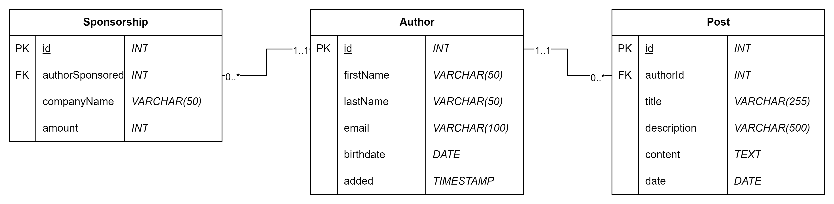
Try it out
Download/import the blog database
Solve all the blog_prepared.mysqlnotebook queries
Stop at the stored procedures

Slide 9
Stored Procedures
Remember functions in python?
DELIMITER //
CREATE PROCEDURE updateCadetGrade(IN cNum CHAR(10), IN newGrade CHAR(1)) BEGIN INSERT INTO GradeArchive SELECT * FROM Grade AS g WHERE g.cNum = cNum; UPDATE Grade AS g SET letterGrade = newGrade WHERE g.cNum = cNum; END
DELIMTER ;
CALL updateCadetGrade(‘1234567890’, ‘B’);

Slide 10
Stored Procedures
Can perform multiple operations in one call
Helpful to protect against SQL Injections
Enforce business rules as close to the database as possible
More granular permissions available’
Stored in the active database, persist after the session
Some paradigms only allow stored procedures to access the database
Cannot use SQL directly
Cannot use prepared statements or the prepared API

Slide 11
Stored Procedures (OUT variables)
DELIMITER //
CREATE PROCEDURE worstCadet(OUT cNum CHAR(10)) BEGIN SELECT g.cNum INTO cNum, MIN(grade) FROM Grade ORDER BY grade ASC LIMIT 1; END
DELIMTER ;
SET @theGOAT = ‘’;
CALL worstCadet(@theGOAT);
SELECT @theGOAT;

Slide 12
Try it out

